Slide 1
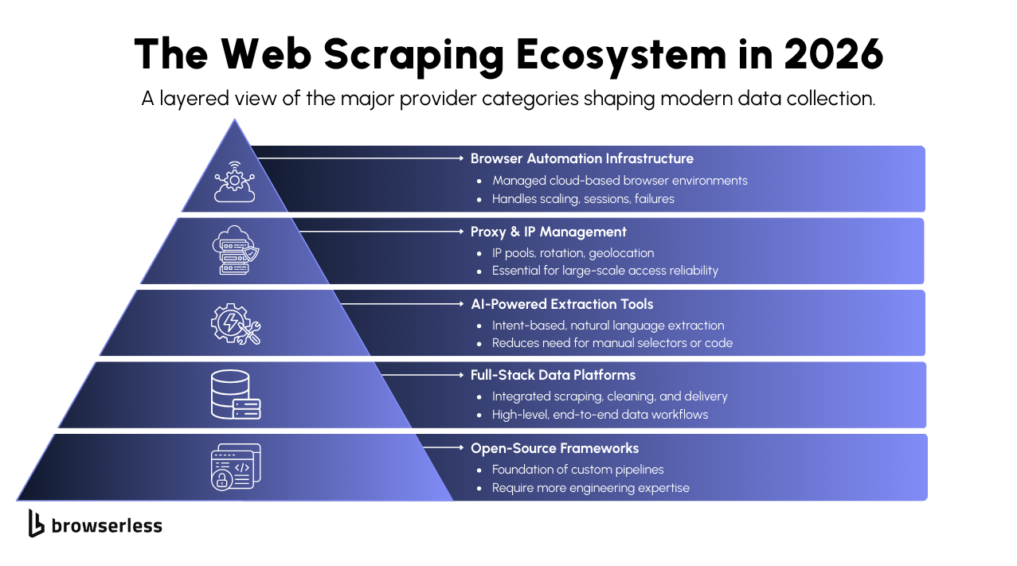
The Evolution of Scraping
Static vs. Dynamic: Basic tools (like BeautifulSoup) only see the initial HTML. Modern sites (Facebook, LinkedIn, Dashboards) load data dynamically as you scroll or click.
Selenium: A "Browser Automator" that physically opens a browser window, clicks buttons, types in search bars, and waits for elements to appear.
The Virtual Human: Why simulating human behavior is necessary for high-value data extraction in 2026.

Slide 2
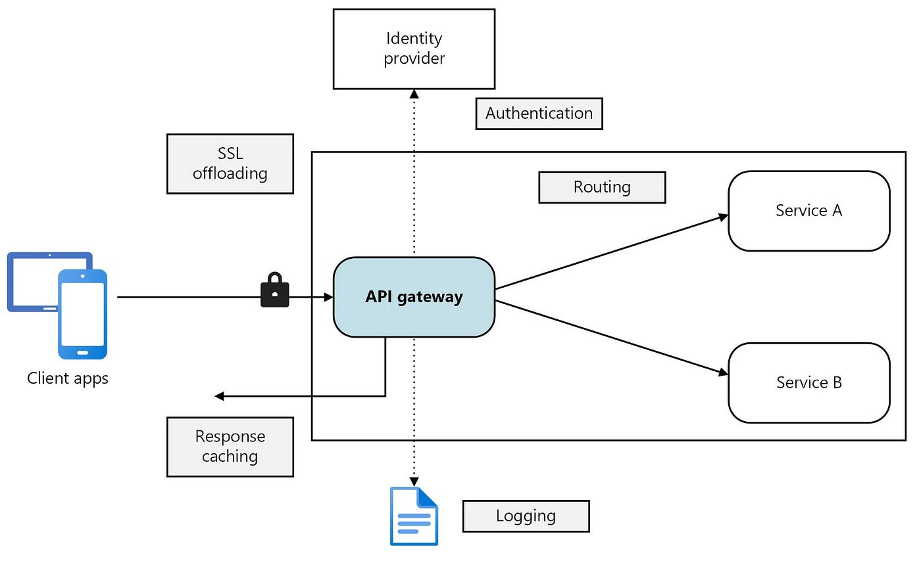
API Integration – The "Front Door"
What is an API?: Instead of "scraping" the visual website, we talk directly to the server's data source.
The Data Pipeline: Building a script that wakes up every morning, asks an API (like OpenWeather or a Financial API) for the latest numbers, and saves them automatically.
Efficiency: APIs are faster, more reliable, and legal compared to raw scraping.

Slide 3
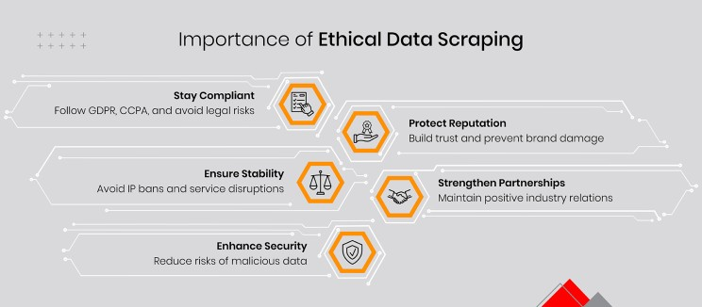
Ethical Scraping & Security
The "Block" Problem: Websites track how many requests you send. If you go too fast, your IP address will be banned.
Rate Limiting: Teaching your code to "sleep" between actions to mimic human reading speed.
IP Rotation: Using a pool of different addresses to distribute your requests, making your bot look like hundreds of different users.
Robots.txt: Learning how to read a website's "Rules of Engagement" before you start scraping.

